Slide 1
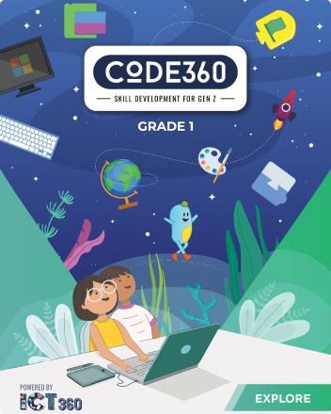
Mazen
Saad
Computer teacher

Slide 2
ICT
Grade 1

Slide 3

Enter the notebook and write the following:

Slide 4
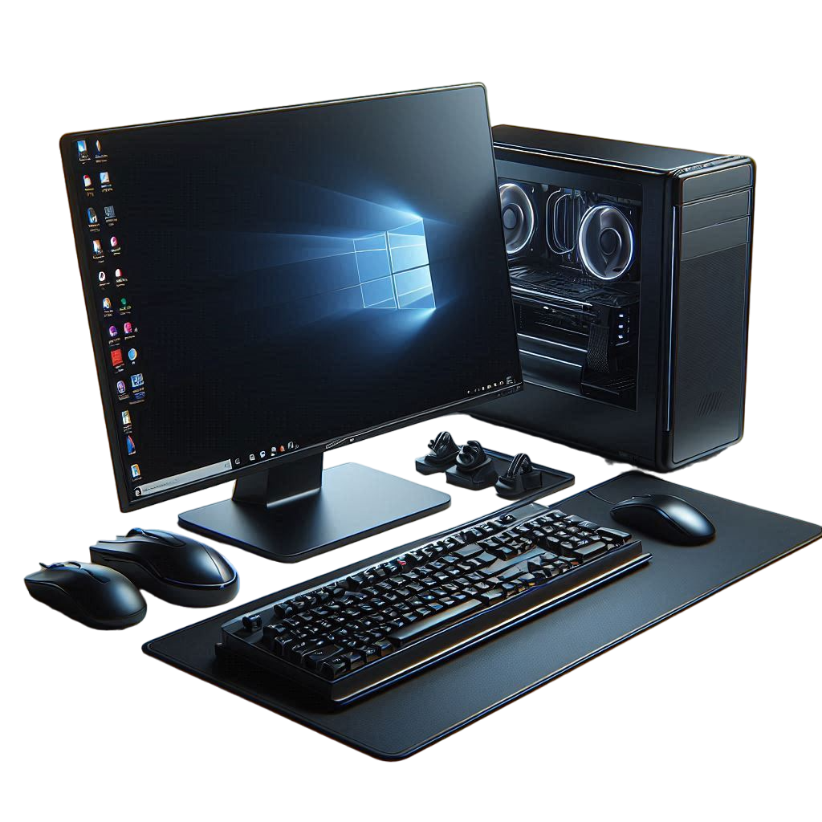
Lesson title
Need of Computers
The Date
2025 / 9 /

Slide 5
1- Computer can do some tasks like: - Playing music. - Playing videos. - Taking pictures. - Letting us write using the keyboard. - Calaulating numbers.

Slide 6
Start

Slide 7



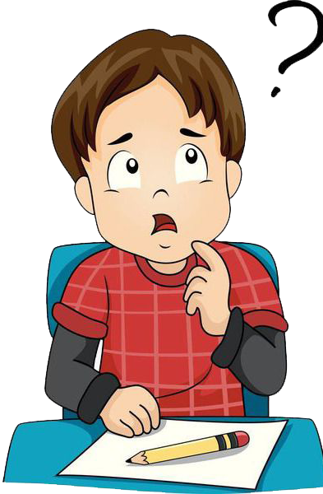

Do you know what this is?

Slide 8
Desktop Computer

Slide 9
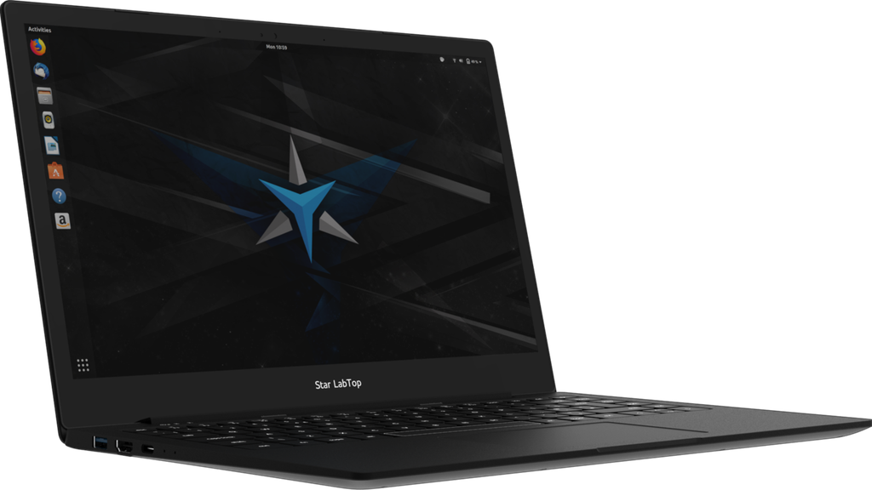

Do you know what this is?

Slide 10
Labtop

Slide 11
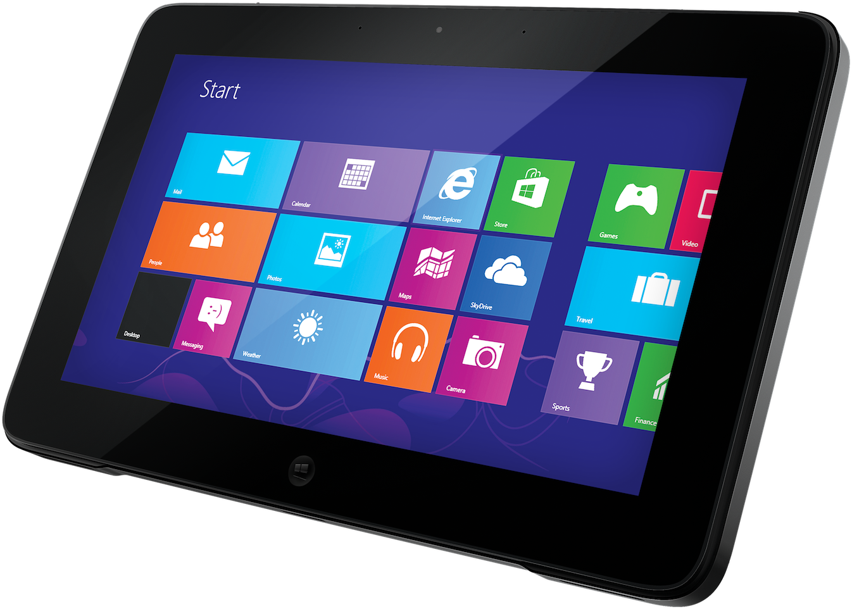
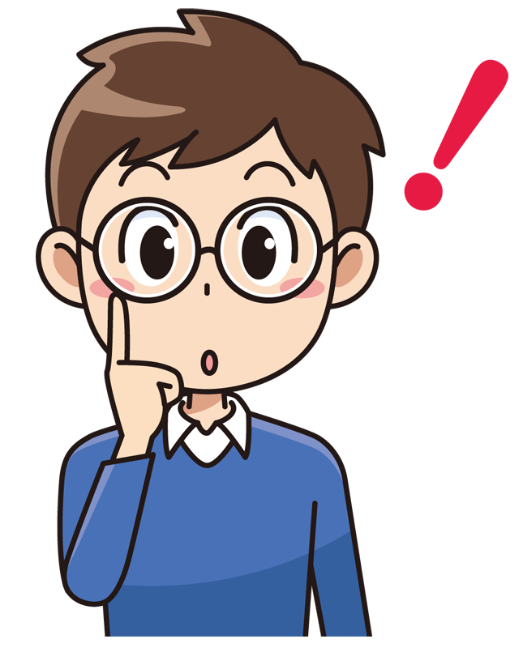
Do you know what this is?

Slide 12
Tablet

Slide 13
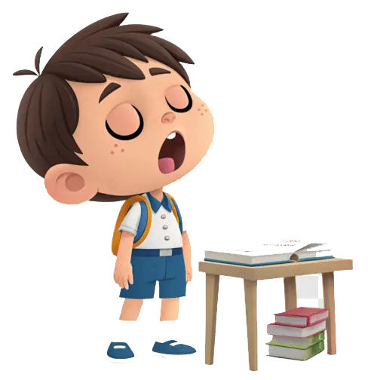
We follow the explanation
Yes Or No

Slide 14
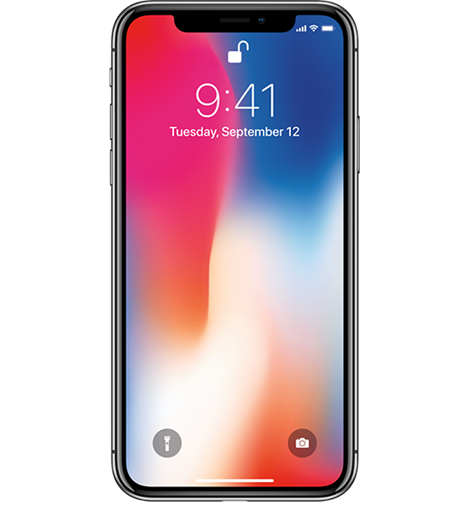

Do you know what this is?

Slide 15
SmartPhone Or Phone

Slide 16


Exercise

Slide 17
Page Number 04

Slide 19


Slide 20
Page Number 07

Slide 23
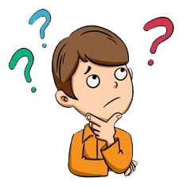

Slide 25

Homework

Slide 26
Page Number 06

Slide 27

Thank you for everything

